Slide 1


Project Stage II SPPU Examination
Sign Language Recognition Using Python and OpenCV
SURAJ ADSUL 4101001
AMIT DIGHE 4101014
SAURABH WANKHEDE 4101056
Name of the guide :- Ms S.B. BORHADE
Department of Computer Engineering,
Sinhgad Institute of Technology and Science, Pune
2021-22

Slide 2
Agenda
Introduction of Group Members
Introduction of Project Topic
Motivation
Literature Survey
Problem Statement
Objectives
System Architecture / Block Diagram
Algorithm / methadology
Module-wise description
Implementation details
Hardware and Software requirements
Dataset Description
Applications and Advantages
Conclusion
Future scope
References
20-05-2022
Sign Language Recognition Using Python and OpenCV
2

Slide 3

Introduction of Group Member 1
Recent Photo 4.05cm ht
Bio – Data : Personal Information
Roll No | 4101014
Name of Student | Amit Subhash Dighe
Date of Birth | 11/06/1999
Address House No Bldg No | Plot no. 3, s. no. 222/3a/2,
Lane, Appt,Society | Tathe nagar, b/h shinde mala
City District | Savedi, Ahmednagar
Tal Dist State Pin | Ahmednagar, 414003
Email id | amit.dighe1@gmail.com
Mobile No. | 7588539924
20-05-2022
Sign Language Recognition Using Python and OpenCV
3

Slide 4
Introduction of Group Member 1
Academic Track Record
Class | Sem | Year of Adm | % Marks | Remark
F. E. | I | 2017-2018 | 60%
 | II |  | 65%
S. E. | I | 2019-2020 | 70%
 | II |  | 75%
T. E. | I | 2020-2021 | 80%
 | II |  | 80%
B. E. | I | 2021-2022
20-05-2022
Sign Language Recognition Using Python and OpenCV
4

Slide 5
Introduction of Group Member 2
Recent Photo 4.05cm ht
Bio – Data : Personal Information
Roll No | 4101001
Name of Student | Suraj Navnath Adsul
Date of Birth | 29/09/2000
Address House No Bldg No | Ekta nagar
Lane, Appt,Society | Diksal kalamb
City District | Osmanabad
Tal Dist State Pin | Kalamb(413507)
Email id | surajadsul415@gmail.com
Mobile No. | 7057633345
20-05-2022
Sign Language Recognition Using Python and OpenCV
5

Slide 6
Introduction of Group Member 2
Academic Track Record
Class | Sem | Year of Adm | % Marks | Remark
F. E. | I | 2018-2019 | 81.66%
 | II |  | 80.96%
S. E. | I | 2019-2020 | 75.59%
 | II |  | 70.57%
T. E. | I | 2020-2021 | 74.88%
 | II |  | 65.64%
B. E. | I
20-05-2022
Sign Language Recognition Using Python and OpenCV
6

Slide 7
Introduction of Group Member 3
Recent Photo 4.05cm ht
Bio – Data : Personal Information
Roll No | 4101056
Name of Student | Saurabh Pradip Wankhede
Date of Birth | 05/05/1998
Address House No Bldg No | Maratha nagar
Lane, Appt,Society | akola
City District | akola
Tal Dist State Pin | Akola Maharashtra (444001)
Email id | saurabhwankhede171@gmail.com
Mobile No. | 8668482175
20-05-2022
Sign Language Recognition Using Python and OpenCV
7

Slide 8
Introduction of Group Member 3
Academic Track Record
Class | Sem | Year of Adm | % Marks | Remark
F. E. | I | 2018-2019 | 81.66%
 | II |  | 80.96%
S. E. | I | 2019-2020 | 65.35%
 | II |  | 70.57%
T. E. | I | 2020-2021 | 72.55%
 | II |  | 65.64%
B. E. | I
20-05-2022
Sign Language Recognition Using Python and OpenCV
8

Slide 9
Introduction
Sign Language Recognition is one of the popular topics of research in the emerging trend. Sign Language Recognition projects help to fill the communication gap between the specially-abled (deaf-mute) people and the normal people.
Usually, deaf-mute people feel difficult to express their feelings to others as the normal feel tough to understand their gesture language. Hence, the opportunities for the deaf-mute people are low.
This can be avoided by creating a platform that can communicate between the deafmute people and normal people by recognising the specially-abled people gesture and converting it to text/voice and vice versa. Hence, in this paper we aim to initialise this long term project by successfully completing until formation of words through the letters recognised out of the gestures of deaf-mute people. We were also successful in recognising certain words that have their own gestures.
This proves to be a one big successful step for creation of the Sign Language Recognition platform. To make it effective economically and qualitatively, we have used simple technologies such as Python, Tensorflow, Keras and OpenCV that are available easily.
20-05-2022
Sign Language Recognition Using Python and OpenCV
9

Slide 10
Literature Survey
This section presents the explanation of the involvement of Convolutional Neural Networks in major domains and list presents the overview of CNN studies involved in different domains.
3 D object generation
Analyse shapes in images
Human motion capturing
Recognition of high-quality 3D objects
Face detection
Face Image Mapping
Face animation
Cross-domain face synthesis
Text transferring
Studying realistic labelled data
Sorting high-quality data by desired algorithms
Pandemics
COVID-19 detection with chest images
Diagnose coronavirus disease pneumonia
Image processing
Recovering of high-resolution images
Perform image comparisons
Generate information from 3D images and 2D images
20-05-2022
Sign Language Recognition Using Python and OpenCV
10

Slide 11
Literature Survey
Sr No | Title | Author/Publication | Detail of Paper
1 | A new framework for sign language alphabet hand posture recognition using geometrical features through artificial neural network, 19 August 2020 | Hoshang Kolivand, Saba Joudaki, Mohd Shahrizal Sunar, David Tully | Then, an artificial neural network is used to drive desired outcomes. ASLNN is proficient to hand posture recognition and provides accuracy up to 96.78% which will be discussed on the additional paper of this authors in this journal.
2 | Real time Finger Tracking and Contour Detection for Gesture Recognition using OpenCV,2016 | Ruchi Manish Gurav, Premanand K. Kadbe | Human Computer Interaction(HCI) is a new technology that is being developed to deliver commands given by the user to the robots. Interaction with machines by the users can be through facial expressions, head, voice, hand, touch, etc.
3 | Sign Language Translator Application Using OpenCV, 2017 | LTriyono, E H Pratisto, S A T Bawono, F A Purnomo, Y Yudhanto and B Raharjo. | This research focuses on the development of sign language translator application using OpenCV Android based, this application is based on the difference in color. The author also utilizes Support Machine Learning to predict the label.
4 | STUDY OF VISION BASED HAND GESTURE RECOGNITION USING INDIAN SIGN LANGUAGE 2014 | Archana S. Ghotkar and Dr. Gajanan K. Kharate | Human Computer Interaction moves forward in the field of sign language interpretation. Indian Sign Language (ISL) Interpretation system is a good way to help the Indian hearing impaired people to interact with normal people with the help of computer.
20-05-2022
Sign Language Recognition Using Python and OpenCV
11

Slide 12
Literature Survey
Sr No | Title | Author/Publication | Detail of Paper
5 | ASL Recognition with MediaPipe and Recurrent Neural Networks, 28. July 2020 | Antonio Domenech L. | this paper proofs it is possible to recognize four dierent with an accuracy of 92%, in real time, and with a mobile phone or computer camera.
6 | Sign Recognition and Speech Translation Using OPENCV , Nov 2020 | Akshay Goel1, Raksha Tandon2, Mandeep Singh Narula3 | In this paper a way is suggested to convert ASL into human understandable language so that deaf and dumb.
7 | Hand Gesture Recognition using Computer Vision,2013 | Ashutosh Samantararay, Sanjay Kumar Nayak, Ashis Kumar Mishra. | A survey on the methods of analysing, modelling and recognizing hand gestures in the context of the HCI is provided in this paper.
8 | A Survey on Sign Language Recognition Systems , 3 March 2021 | Shruty M. Tomar, Dr. Narendra M. Patel, Dr. Darshak, G. Thakore | Sign language recognition can be done by two methods. First one is sensor based technique, in this technique a sensor based wearable gadgets are used such as gloves. Second approach involves computer vision based methods
20-05-2022
Sign Language Recognition Using Python and OpenCV
12

Slide 13
Motivation
The 2011 Indian census cites roughly 1.3 million people with “hearing impairment”. In contrast to that numbers from India’s National Association of the Deaf estimates that 18 million people –roughly 1 per cent of Indian population are deaf.
These statistics formed the motivation for our project. As these speech impairment and deaf people need a proper channel to communicate with normal people there is a need for a system .Not all normal people can understand sign language of impaired people.
20-05-2022
Sign Language Recognition Using Python and OpenCV
13

Slide 14
Objectives
Possible Objectives:
To provide an efficient and accurate way to convert sign language into text or voice
To generate dataset related to gestures for further synthesis.
To train proper model for effective prediction and analysis purpose.
To present a pre-trained CNN model for gesture recognition.
To develop proper and user friendly UI, for fluent user experience for getting desired result from the model.
20-05-2022
Sign Language Recognition Using Python and OpenCV
14

Slide 15
Activities Per Objectives
To provide an efficient and accurate way to convert sign language into text or voice.
Activity:
To take video as input from the user’s camera.
To process the input video.
20-05-2022
Sign Language Recognition Using Python and OpenCV
15

Slide 16
Activities Per Objectives
To generate dataset related to gestures for further synthesis.
Activity:
To create a database for the newly generated outputs.
To store the text/voice message generated from the given input video to the database.
20-05-2022
Sign Language Recognition Using Python and OpenCV
16

Slide 17
Activities Per Objectives
To train a pre-trained CNN model for gesture recognition.
Activity:
To train Stage-I and Stage-II CNN for generation of text or voice message about gestures from input video.
Training Stage-I CNN will recognize the gesture in the given input video.
Stage-II CNN will predict given gesture and display output text or voice message.
20-05-2022
Sign Language Recognition Using Python and OpenCV
17

Slide 18
Activities Per Objectives
To develop proper and user friendly UI, for fluent user experience for getting desired result from the model.
Activity:
To develop a UI for user to give video input and convert sign language into text or voice.
To learn and Understand Client Side scripting.
20-05-2022
Sign Language Recognition Using Python and OpenCV
18

Slide 19
Problem Statement
Title: Sign Language Recognition Using Python and OpenCV.
Problem Statement:
To train Convolutional Neural Network (CNN) model for recognition of Sign Language gestures from video input and develop a UI which will work using Python and OpenCV.
20-05-2022
Sign Language Recognition Using Python and OpenCV
19

Slide 20
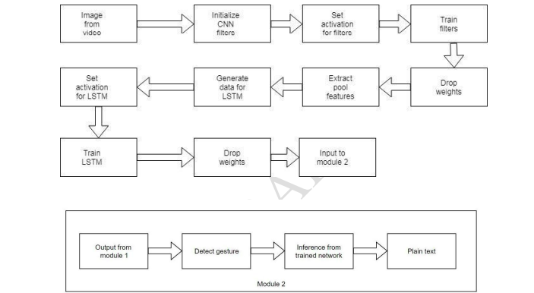
System Architecture/ Block diadram
20-05-2022
Sign Language Recognition Using Python and OpenCV
20

Slide 21
Explaination of Architectural Design
Pooling: Max pooling takes the maximum value of a defined grid.
CNN: CNNs have repetitive blocks of neurons that are applied across space (for images) or time (for audio signals etc). For images, these blocks of neurons can be interpreted as 2D convolutional kernels, repeatedly applied over each patch of the image.
Activation: Activation function helps the linear operation of inputs to a non-linear operation.
LSTM: It is responsible for remembering values over arbitrary time intervals.
Image in RGB: the image captured is in RGB format.
20-05-2022
Sign Language Recognition Using Python and OpenCV
21

Slide 22
Algorithms / Methodology
Algorithm:
Deep learning: There have been several advancements in technology and a lot of research has been done to help the people who are deaf and dumb. Aiding the cause, Deep learning, and computer vision can be used too to make an impact on this cause.
CNN: A set of learnable filters (or kernels), which have a small receptive field, but extend through the full depth of the input volume. During the forward pass, each filter is convolved across the width and height of the input volume, computing the dot product between the entries of the filter and the input and producing a 2-dimensional activation map of that filter.
Methodology: Methodology to be used in SDLC, etc.
SDCL: SDLC is a step by step procedure or systematic approach to develop software. It consists of various phases which tells us how to design, develop, enhance and maintain particular software. It consists of various phases.
20-05-2022
Sign Language Recognition Using Python and OpenCV
22

Slide 23
Module-wise description
Development Module
Testing module
We have developed this project using OpenCV and Keras modules of python.
OpenCV :
Now for creating the dataset we get the live cam feed using OpenCV and create an ROI that is nothing but the part of the frame where we want to detect the hand in for the gestures.
Keras :
Keras is a deep learning API written in Python, running on top of the machine learning platform TensorFlow. It was developed with a focus on enabling fast experimentation. Being able to go from idea to result as fast as possible is key to doing good research. Keras is: Simple -- but not simplistic.
20-05-2022
Sign Language Recognition Using Python and OpenCV
23

Slide 24
Implementation Details
Concerning to the implementation, we have used TensorFlow framework, with keras API.
Our strategy involves implementing such an application which detects pre-defined sign language through hand gestures.
For the detection of movement of gesture, we would use basic level of hardware component like camera and interfacing is required.
Instead of using technology like gloves or kinect, we are trying to solve this problem using state of the art computer vision and machine learning algorithms.
20-05-2022
Sign Language Recognition Using Python and OpenCV
24

Slide 25
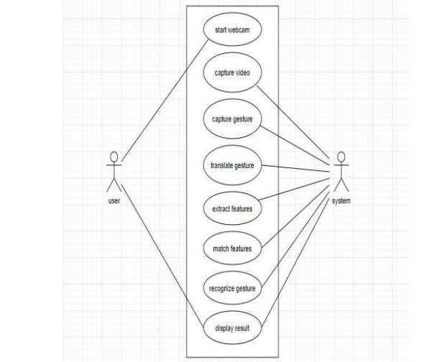
Implementation in Graphical format
20-05-2022
Sign Language Recognition Using Python and OpenCV
25

Slide 26
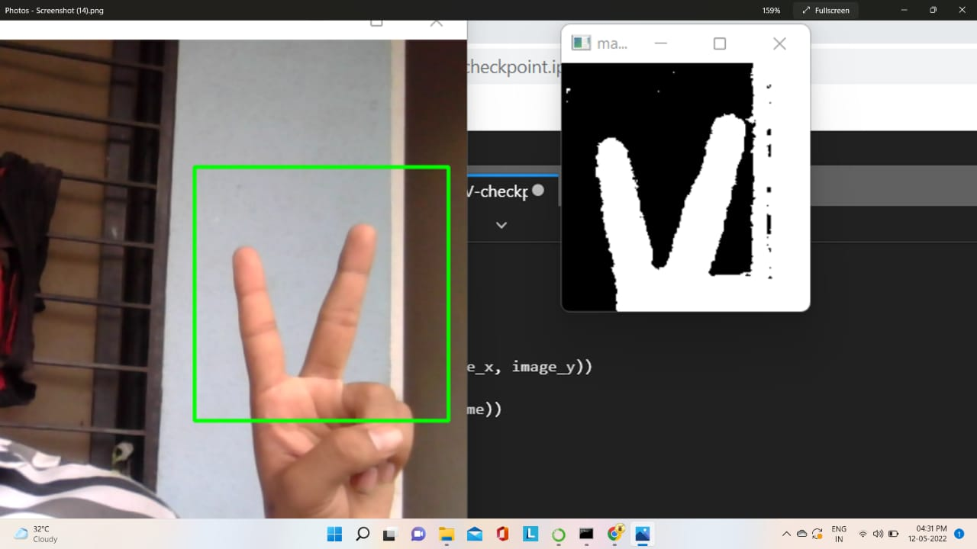
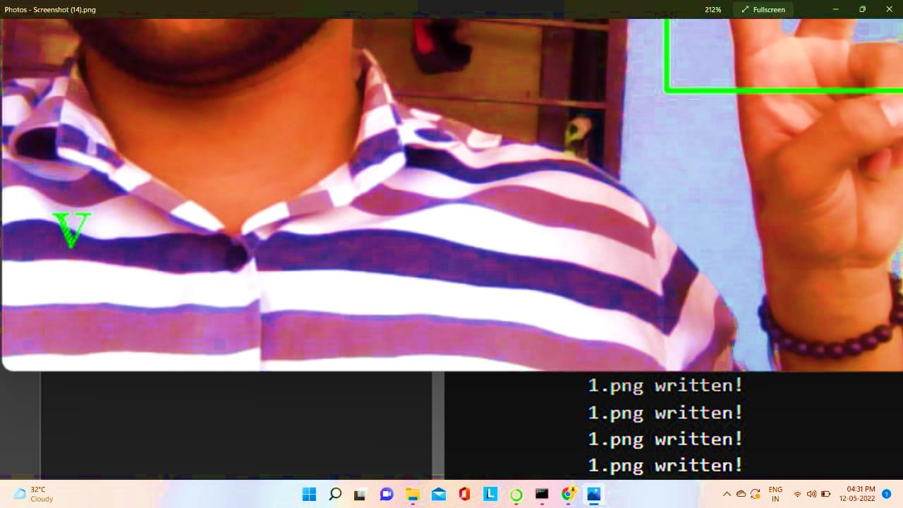
Implementation in Graphical format
20-05-2022
Sign Language Recognition Using Python and OpenCV
26

Slide 27
Hardware and Software Requirements
Hardware Requirements:
• Processor: Intel Core i3 3 rd gen processor or later
• Hard Disk: 512 MB disk space
• RAM: 512 MB
• Camera :(300ppi or 150lpi) 4-megapixel cameras and up
20-05-2022
Sign Language Recognition Using Python and OpenCV
27

Slide 28
Hardware and Software Requirements
Software Requirements (Platform choice)
Microsoft Windows XP or later /Ubuntu 12.0 LTS or later /MAC OS 10.1 or later. Python Interpreter (3.6).
1. Language { Python }
2. Libraries
(a) Numpy
(b) Pandas
(c) OpenCV
(d) Matplotlib
(e) Scikit Learn
(f) Mahotas
(g) Keras
(h) Tensorow
It is recommended to use Anaconda Python 3.6 distribution and using a Jupyter Notebook.
20-05-2022
Sign Language Recognition Using Python and OpenCV
28

Slide 29
Dataset Description
The American Sign Language Letters dataset is an object detection dataset of each ASL letter with a bounding box. David Lee, a data scientist focused on accessibility, curated and released the dataset for public use.
static hand gesture dataset for gestures in American Sign Language (ASL) by hand segmentation, noise reduction and feature extraction from input RGB images.
Statistical information of the ASL dataset is given below - After data augmentation and preprocessing the image samples of 10 sign digits, each of size 400 × 400.
Here, user can create hi own dataset or assign a specific message to a particular hand gesture.
And thus gives us a accuracy of over 96%.
Our Dataset consists of over 45,000 images.
20-05-2022
Sign Language Recognition Using Python and OpenCV
29

Slide 30
Applications and Advantages
Applications:
Sign Language Recognition is a breakthrough for helping deaf-mute people.
The Sign language is a visual language used by the people with the speech and hearing disabilities for communication in their daily conversation activities
It is completely an optical communication language through its native grammar, be unlike fundamentally from that of oral languages.
Advantages:
Real Time Functining : The output of the sign language will be displayed in the text form in real time. This makes the system more efficient and hence communication of the hearing and speech impaired people more easy.
Portable : When this entire project is implemented on Raspberry Pie computer, which is very small yet powerful computer, the entire system becomes portable and can be taken anywhere.
No Need Of Calibration : In sign language recognition using sensors attached to default system.
20-05-2022
Sign Language Recognition Using Python and OpenCV
30

Slide 31
Conclusion
After recognising the hand gestures we also were able to form a word using the gestures to add more functionality to the project which made communication easier between specially-abled people who could not hear or speak.
The images captured through web cam are compared and the result of comparison is displayed at the same time.
Thus this feature of the system makes communication very simple and delay free.
User need not be a literate person if they know the action of the gesture, they can quickly form the gesture and appropriate assigned character will be shown onto the screen.
20-05-2022
Sign Language Recognition Using Python and OpenCV
31

Slide 32
Future Scope
It can be integrated with various search engines and texting application such as google, WhatsApp. So that even the illiterate people could be able to chat with other persons, or query something from web just with the help of gesture.
This project is working on image currently, further development can lead to detecting the motion of video sequence and assigning it to a meaningful sentence with TTS assistance.
20-05-2022
Sign Language Recognition Using Python and OpenCV
32

Slide 33
References
Hoshang Kolivand, Saba Joudaki, Mohd Shahrizal Sunar, David Tully "A new framework for sign language alphabet hand posture recognition using geometrical features through artificial neural network" ,International Journal of Engineering Research and Technology (IJERT), (19 August 2020)
Ruchi Manish Gurav, Premanand K. Kadbe "Real time Finger Tracking and Contour Detection for Gesture Recognition using OpenCV" ,International Journal of Engineering Research and Technology (IJERT), (2016).
LTriyono, E H Pratisto, S A T Bawono, F A Purnomo, Y Yudhanto and B Raharjo, “Sign Language Translator Application Using OpenCV’’, International Journal of Computer Science and Telecommunications, (2017)
Archana S. Ghotkar and Dr. Gajanan K. Kharate, “STUDY OF VISION BASED HAND GESTURE RECOGNITION USING INDIAN SIGN LANGUAGE ’’, International conference on emerging trends in science (2014).
20-05-2022
Sign Language Recognition Using Python and OpenCV
33

Slide 34
References
Antonio Domenech L. ,” ASL Recognition with MediaPipe and Recurrent Neural Networks ”, International Journal of Artificial Intelligenceand Interactive Multimedia, Vol. 2, No 2.,(28. July 2020).
Akshay Goel1, Raksha Tandon2, Mandeep Singh Narula3, “Sign Recognition and Speech Translation Using OPENCV”, AIEEE, Vol. 15 No. (Nov 2020).
Ashutosh Samantararay, Sanjay Kumar Nayak, Ashis Kumar Mishra, “Hand Gesture Recognition using Computer Vision”,(2013)
Shruty M. Tomar, Dr. Narendra M. Patel, Dr. Darshak, G. Thakore “A Survey on Sign Language Recognition Systems ”, Conference: 2013 Fourth International Conference on Computing, Communications and Networking Technologies (ICCCNT) ,(3 March 2021)
20-05-2022
Sign Language Recognition Using Python and OpenCV
34

Slide 35
Thank You!!!
20-05-2022
Sign Language Recognition Using Python and OpenCV
35

